Slide 1
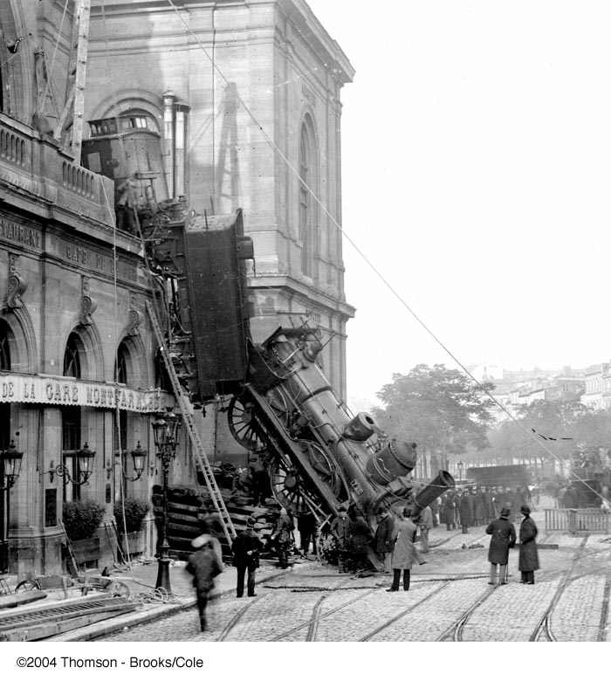
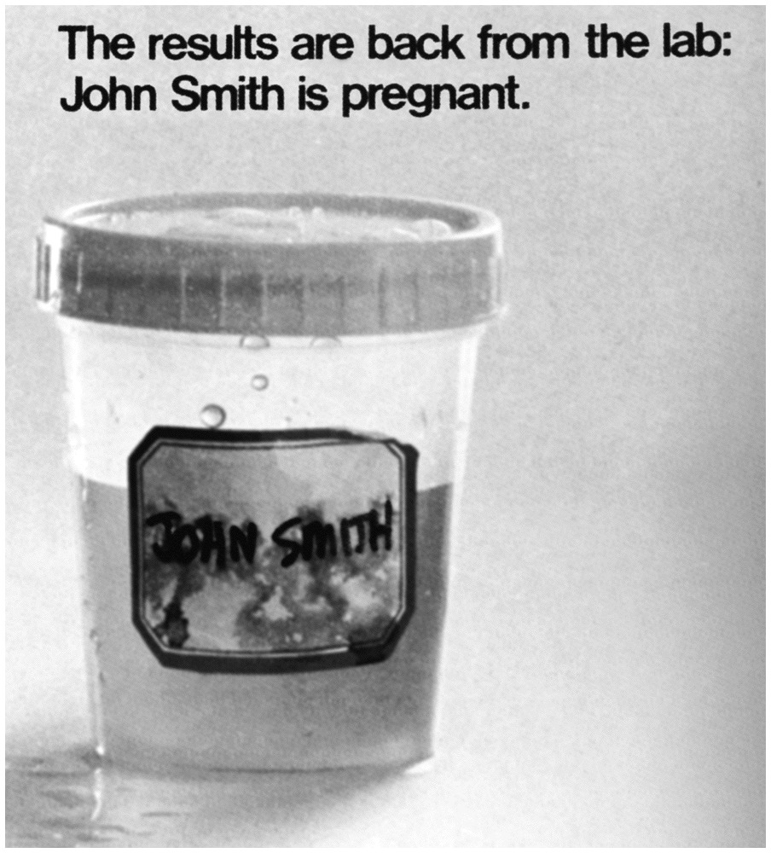
The famous train accident at Montparnasse in Paris: a train from Granville, France on Oct. 22, 1895.

Slide 2
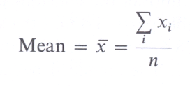
The central tendency of a set of results data
1) Mean
The mean value is the sum of the measured values divided by the total number of values. For n sample determinations
x₁, x₂, x₃, ⋅⋅⋅, x_{n}.
The sample mean, can be calculated by :
This sample mean is an estimate of μ, the actual mean of the population.

Slide 3
2) Median
The median(M) is defined the middle value of data points arranged in order of magnitude. Median is the value above and below which there are an equal number of data points.
For an odd number of points, the median is the middle one.
For an even number of points, the median is halfway between the two center values.
The advantage of M over the mean is that a gross error in one result cause a large error in the mean, but not in M.
Other central tendencies
Geometric mean, Harmonic mean, Mode

Slide 4
Accuracy and precision
Accuracy
Accuracy refers to the closeness of such measurements to the “true” magnitude concerned.
An accurate method of measurement is both precise and unbiased.
Accuracy is therefore a generic term for precision and nearness to the truth.
The determining factor for the overall error is the largest individual error.
The random error may be decreased by a factor √n by repeating the analyses n times. Systematic error may only be eliminated by the elimination of its cause.

Slide 5
Precision
Precision (or reproducibility) refers to the agreement among repeated measurements of a given sample.
Precision shows only how closely many measurements agree, while accuracy shows how closely a method measures what it is supposed to measure.
Precision is specified by the standard deviation of the results.

Slide 6
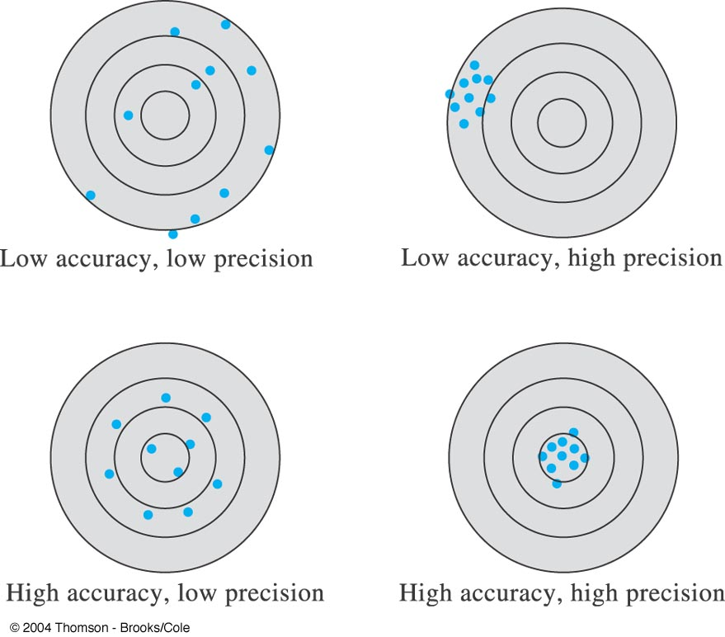
imprecise
precise

Slide 7
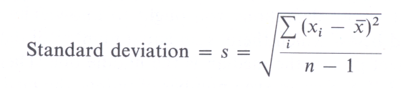
Expressing precision
Deviation : d = | x_{i} − x |
Note that deviations from the mean are calculated without regard
to sign.
Standard deviation
The standard deviation measures how closely the data are
clustered about the mean.
A small s is more reliable(precise) than large standard deviation.

Slide 8
Variance
The variance is the square of the standard deviation.
V = s²

Slide 9
Absolute error and relative error
Absolute error = the margin of uncertainty associated with a measurement
Absolute error(±) = E = x_{i}− x_{t}
Relative error(%) = E_{r} = {(x_{i}− x_{t}) / x_{t} } × 100
ex. Tolerance of A class transfer pipet = 20 ml ±0.03 ml
Absolute error = ±0.03 ml
Relative error = ⎜0.03 ml⎜/ 20 ml = 0.0015
Percent relative error = 0.15%

Slide 10
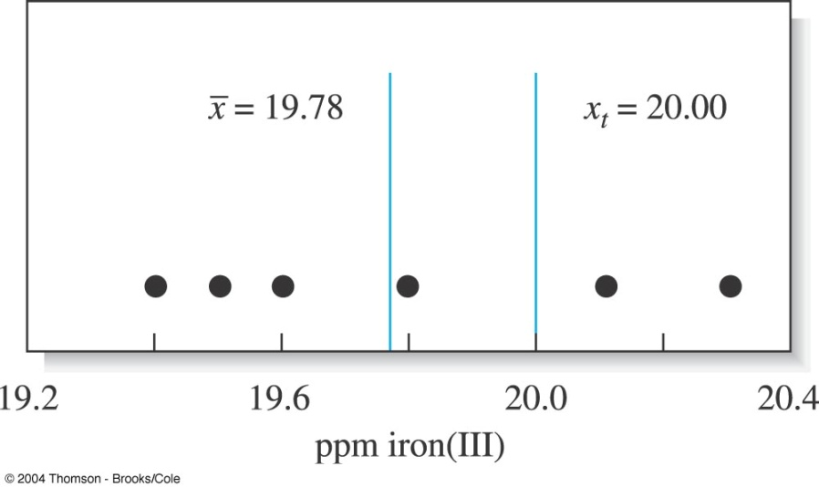
Results from six replicate determinations of iron in aqueous samples of a standard solution containing 20.0 ppm iron(III).
E = 19.8 − 20.00 = − 0.2
E_{r} = {(19.8 − 20.00)/20.0} ×100%
= −1%

Slide 11
Error Types
Random Error (indeterminate)
Systematic Error (determinate)
Gross error

Slide 12
    Random error
    The difference between the characteristic values obtained from the analysis and the expected value (the mean result obtained by continuously repeated experiments)
    This error is randomly distributed to higher and lower values.
    It is brought about by the effects of uncontrolled variables. Random errors can not be eliminated by corrections.
    However, their influence on the result can be lessened by using a mean value obtained from several independent determinations.
    Random errors determine the reproducibility of measurements and therefore their precision.
    The precision of the results decreases, the scatter increases.
    Examples : noise of radiation and voltage source, inhomogeneities of solids.

Slide 13
Systematic error
    Causes the mean of a data set to differ from the accepted value
    Determinate or systematic errors can be assigned to definite causes.
    Such errors are characterized by being unidirectional
    It is possible to avoid or eliminate systematic errors if their causes are known.
    Their existence and magnitude characterize the accuracy of a result of measurement.
    Systematic errors affect the accuracy of results.
    The accuracy of the results decreases.

Slide 14
Sources of Systematic errors
Instrumental errors
Method Errors
Personal Errors

Slide 15
Effect of Systematic Errors
    Constant systematic error:
    The amount of a systematic error is independent of analyte, which leads to a parallel displacement of the matrix calibration line. The cause of this error may be the co-detection of a matrix component.
    Proportional systematic errors : The amount of a systematic error increases or decreases with the amount of analyte.
    Examples : method bias, laboratory bias, instrumental bias.
Signal
2 (constant systematic error)
1 (ideal pure standard)
3 (proportional systematic error)
Analyte concentration
Representation of systematic errors.
W. Funk, V. Dammann, G. Donnevert, Quality Assurance in Analytical Chemistry, VCH, 1995.

Slide 16
Method 1
Method 2
Method 3
True value
Effect of systemic and random errors upon analytical results

Slide 17
Gross Error
Gross error usually occur only occasionally
They are often a product of human errors
Gross errors lead to outliers
These are results that appear to differ significantly from all other data in a set of replicate measurements

Slide 18
Systematic error
Mean
True value
Outlier
Range of random errors
Schematic representation of systematic and random errors.
Helmut Gunzzler(Ed.) ; Accreditationn and Quality Assurance in Analytical Chemistry, Springer, Berlin, 1994, p.106.

Slide 19
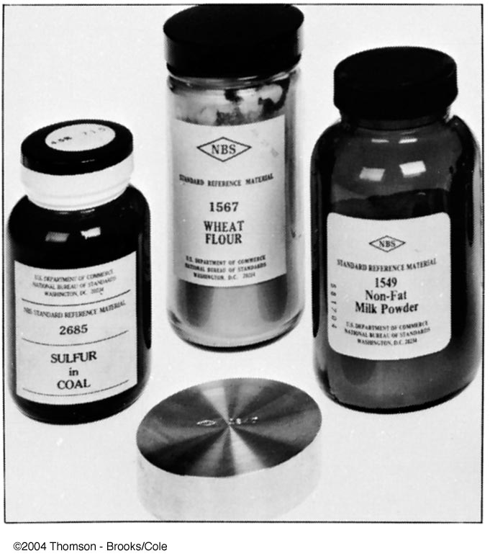
Detection of systematic instrument and personal errors
Periodic calibration of equipment
Care and self discipline
Detection of systematic methods errors
Analysis of standard samples (standard reference materials: SRM)
Independent analysis
Blank determinations
Variation in sample size

Slide 20
Categories of Errors
  sample errors
  reagent errors
  reference material error
  method errors
  calibration errors
  equipment errors
  signal registration and recording errors
  calculation errors
  transmission errors
  errors in the reporting of result

Slide 21
Significant figures
The number of significant figures is the number of digits
needed to write a given value in scientific notation without
loss of accuracy.
8.25 × 10⁴ 3 significant figures
8.250 × 10⁴ 4
8.2500 × 10⁴ 5
0.801 3
0.0801 3
0.8010 4

Slide 22
Rules for determining the number of significant figures:
Discard all initial zeros
Disregard all final zeros unless they follow a decimal point
All remaining digits, including zeros between nonzero digits, are significant

